Slide 1
The current transport in
Nitra

Slide 2
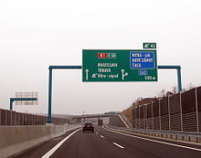
Transport in Nitra
Expressways
In 2011 the speedway R1 was opened, it connects Nitra with important cities such as Bratislava, Trnava, Banska Bystrica and Zvolen.
Integrated Transport
Nitra is one of the places in which it is considered to introduce an integrated transport normal for European cities and regions.
The involved ways should include:
*City transport – operated by the main carrier ARRIVA Nitra
*suburban bus transport - owner HTU Nitra, carrier ARRIVA
*long distance bus transport - owner HTU Nitra, carrier ARRIVA
*Railway transport – state-owned, the carrier Railway Company Slovakia

Slide 3
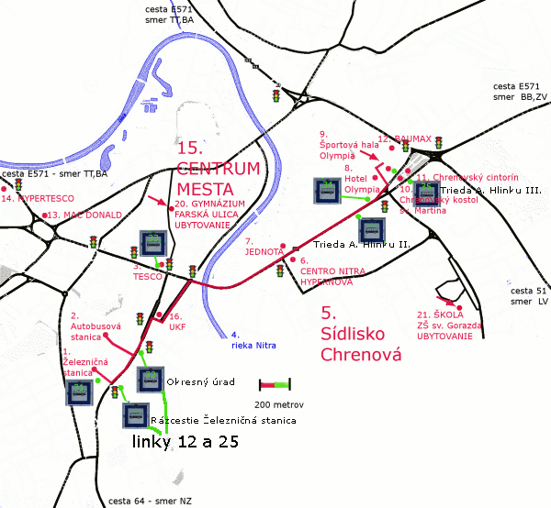
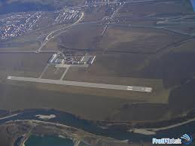
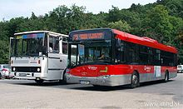
Public transport
Is relatively well-developed, connects town with urban areas, industrial areas, but also the surrounding communities (29 lines + 2 seasonal lines). Transportation is provided by Arriva Nitra.
Air transport
Nitra airport is the only airport with regional significance located in the citypart Janíkovce.

Slide 4
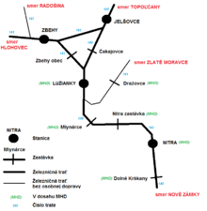
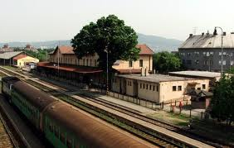
Rail transport
Rail transport in Nitra is currently made ​​of three lines:
line 140 - a single-track non-electrified New Castle - Prievidza
line 141 - a single-track non-electrified Leopoldov - Kozárovce
line 142 - a single-track non-electrified Zbehy - Radošina

