Slide 1
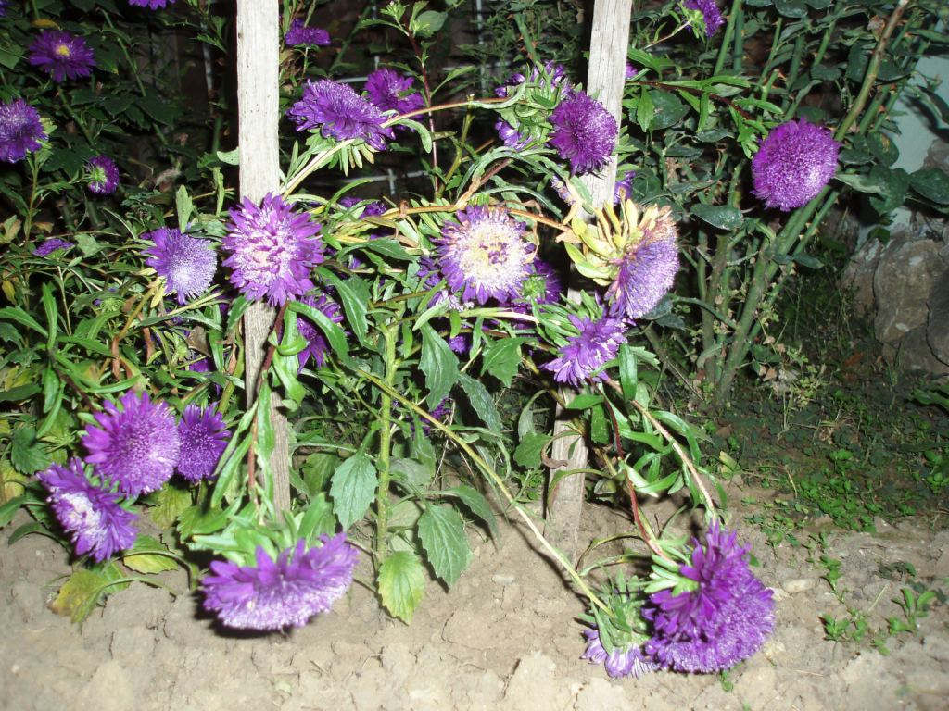
Life of our project plant

Slide 2
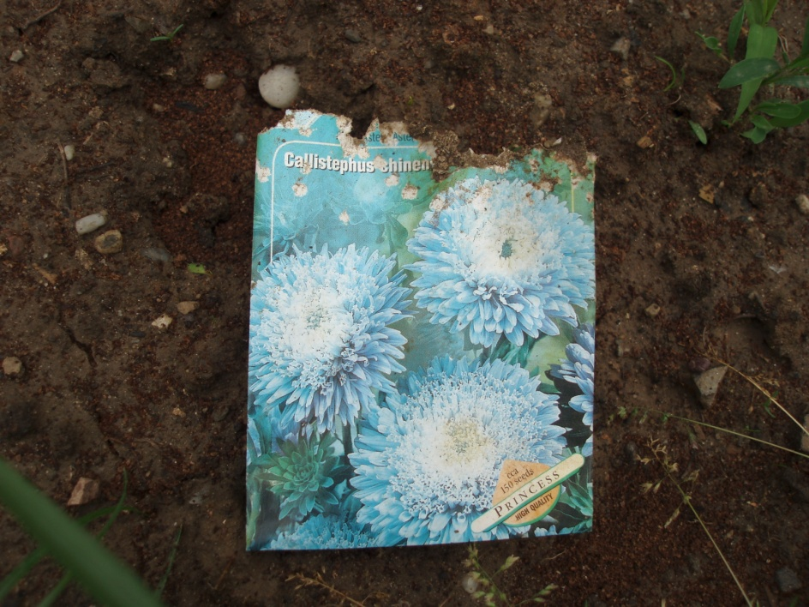
This is our plant
Callistephus chinensis
First day - planting

Slide 3
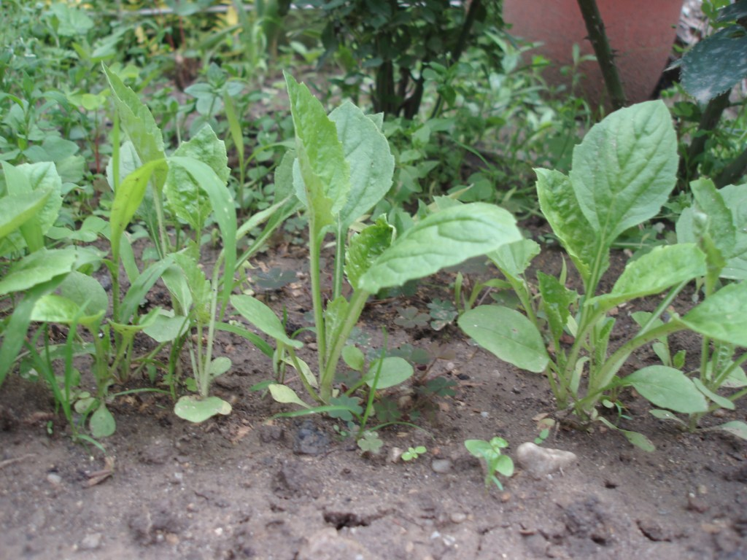
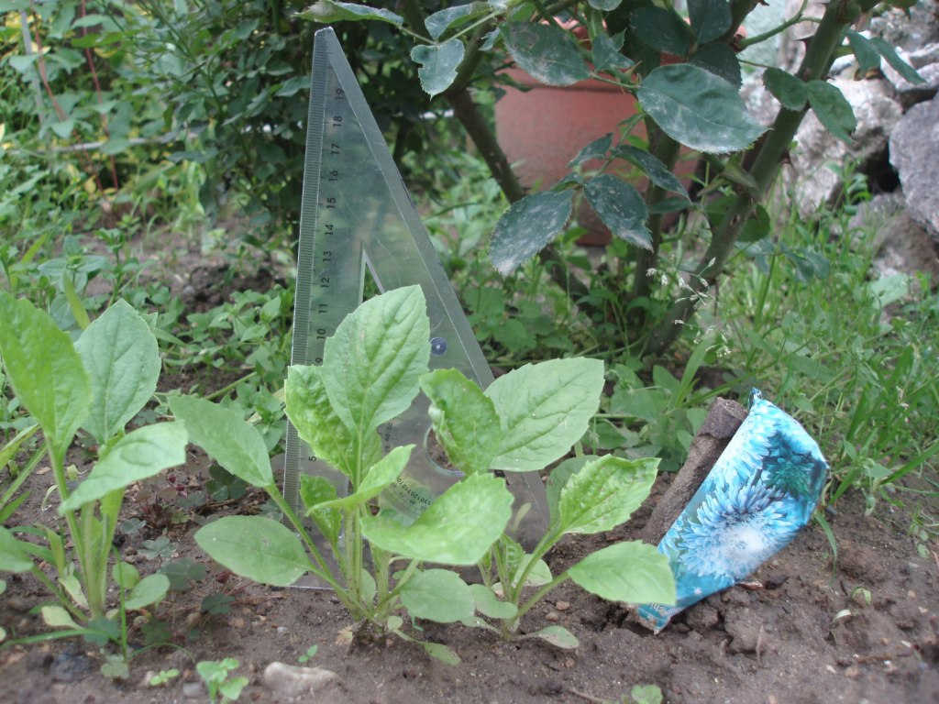
After a few weeks
4th June – 12 cm

Slide 4
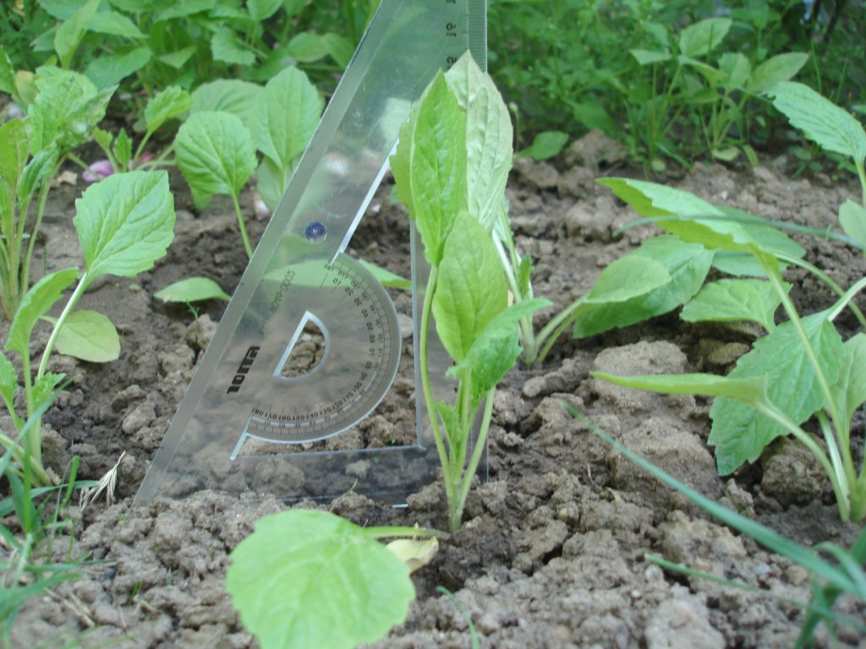
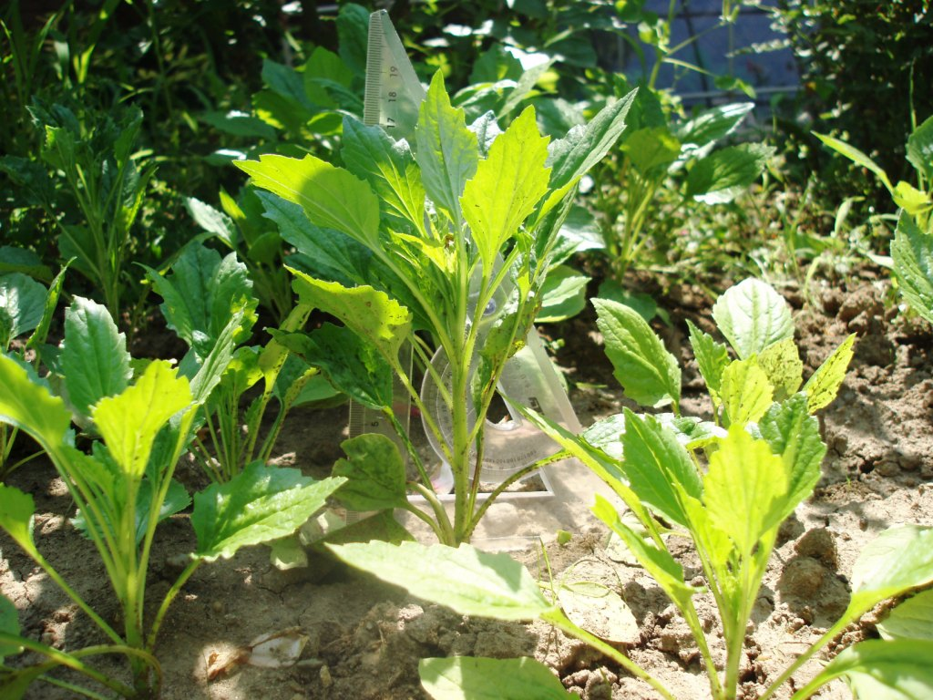
After a few days
15th June – 15,5 cm ↓
←
29th June –19 cm→

Slide 5
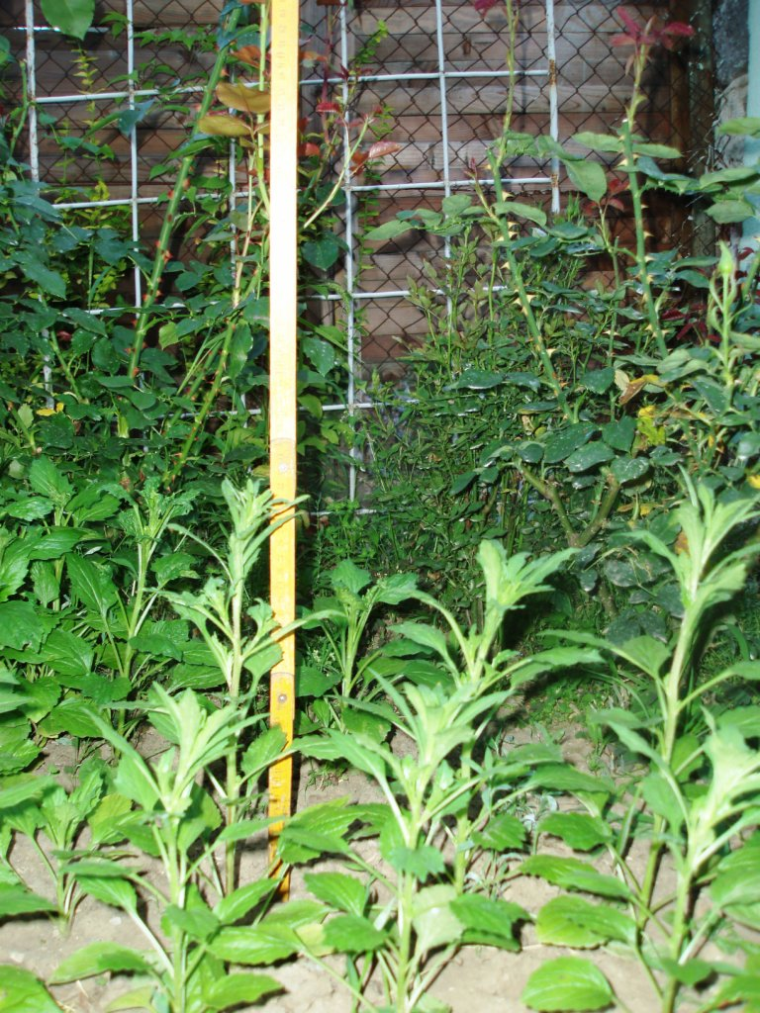
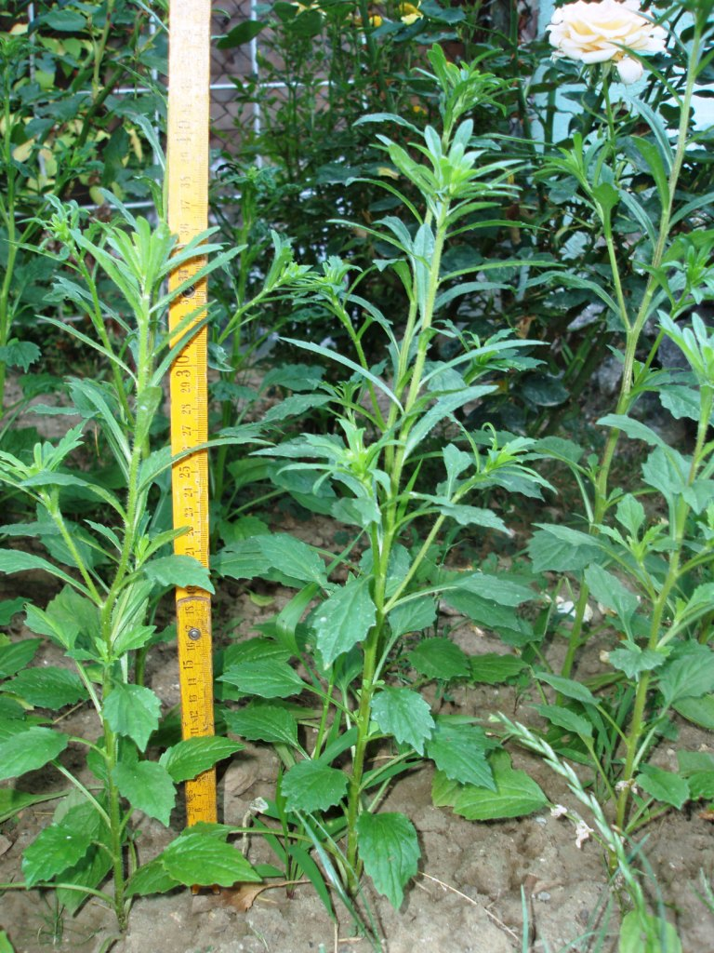
July – Still leaves
15th July – 28 cm
→
27th July – 42 cm
←

Slide 6
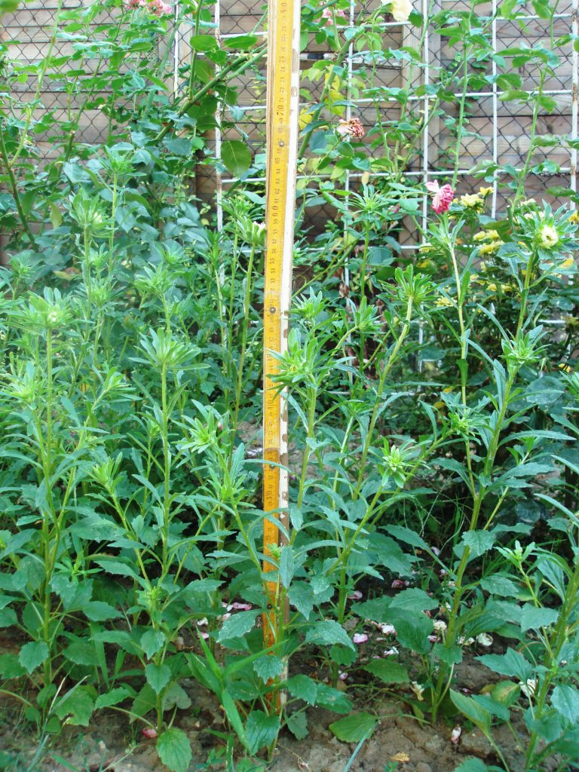
Early August – Begining of blooming
11th August
- 54 cm

Slide 7
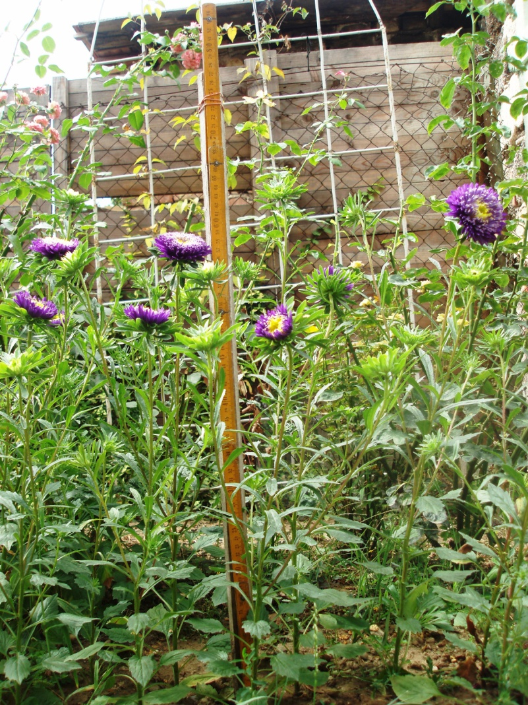
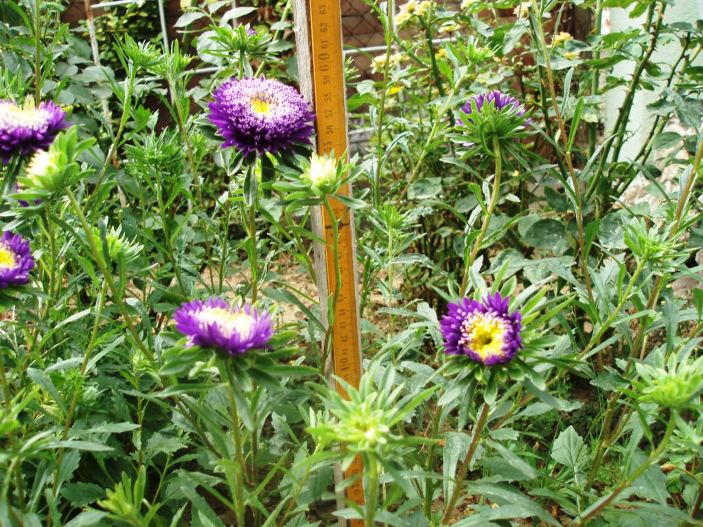
End of August - Flowers
23rd August – 59 cm

Slide 8
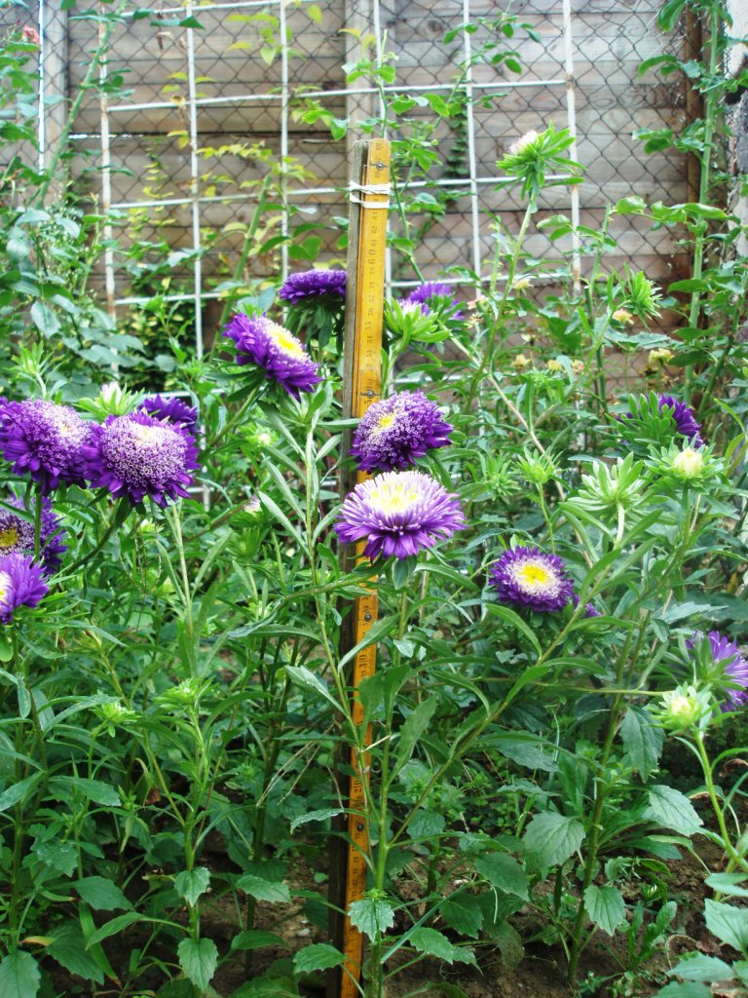
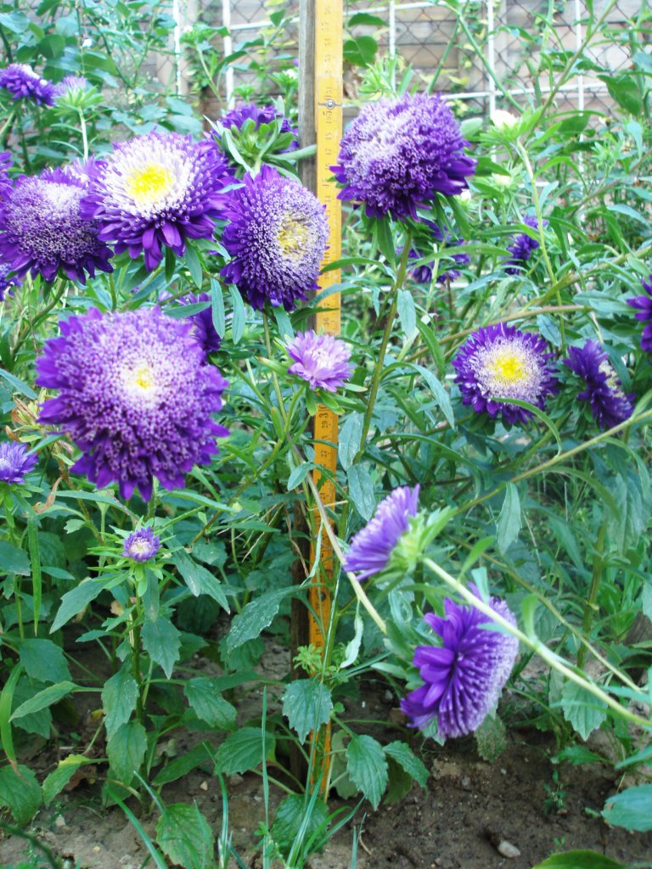
September – Our purple flowers
1st September
8th September

Slide 9
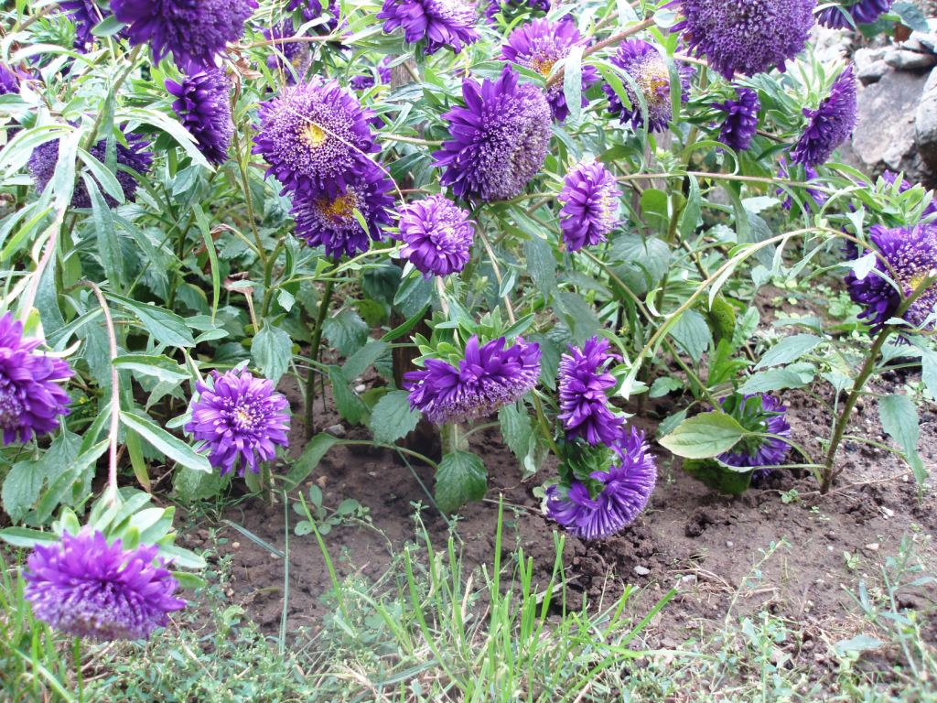
September - Our purple flower
15th September

Slide 10
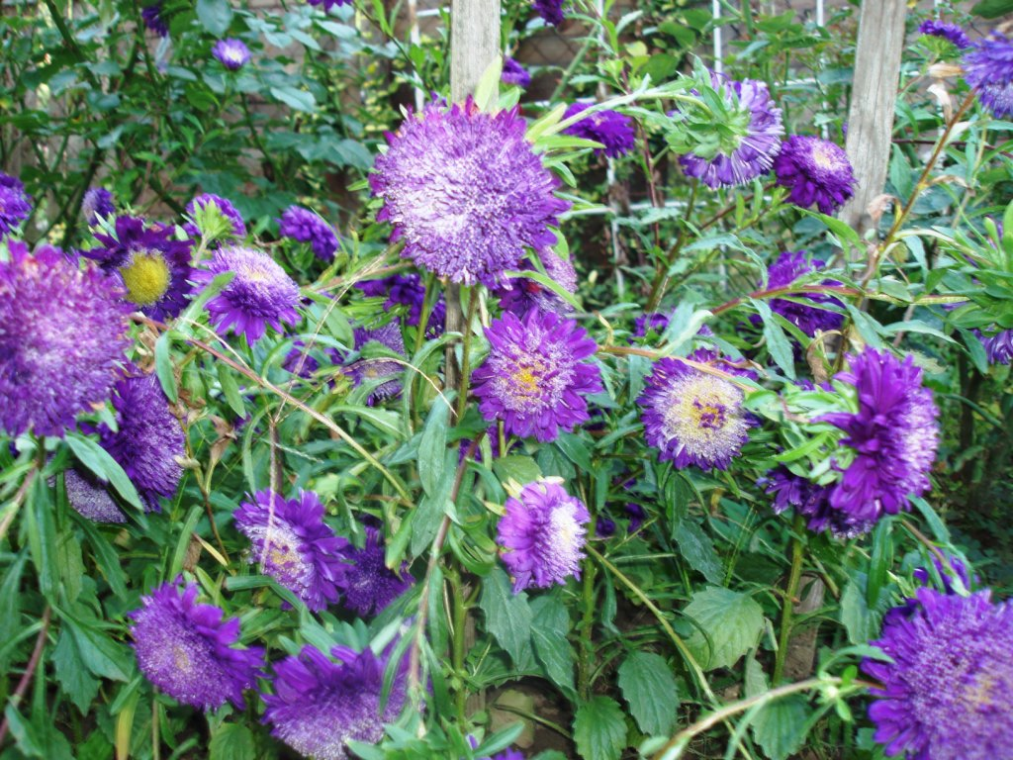
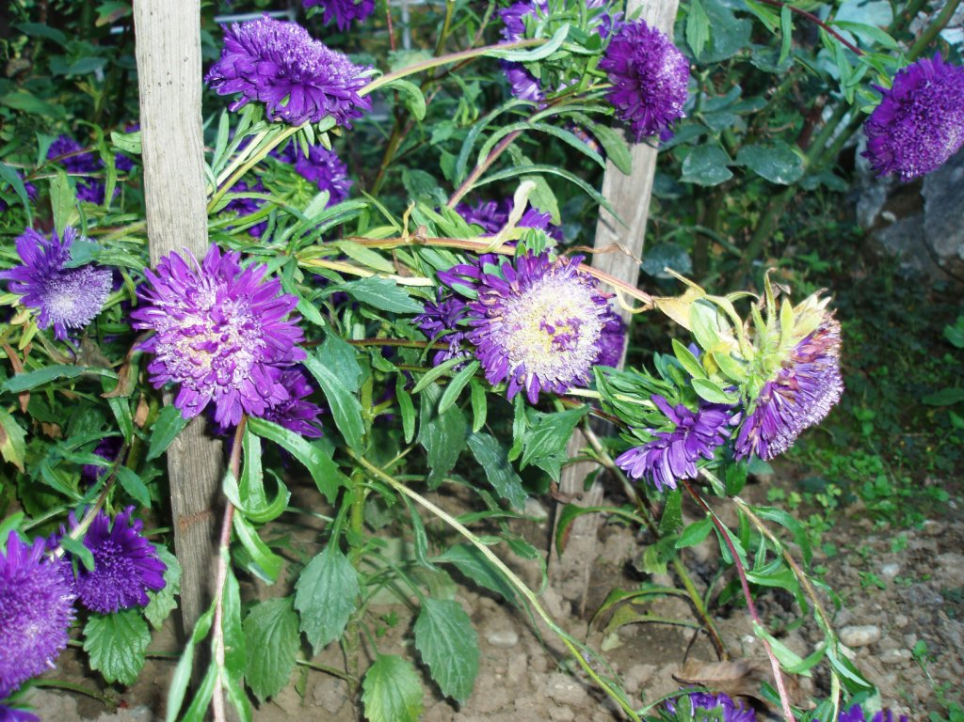
September – Still beautiful
22nd September
27th September

Slide 11
October – End of our project plant
1st October - Last photo

